Slide 1
Chapter 14 JavaFX Basics

Slide 2
Objectives
To distinguish between JavaFX, Swing, and AWT (§14.2).
To write a simple JavaFX program and understand the relationship among stages, scenes, and nodes (§14.3).
To create user interfaces using panes, UI controls, and shapes (§14.4).
To use binding properties to synchronize property values (§14.5).
To use the common properties style and rotate for nodes (§14.6).
To create colors using the Color class (§14.7).
To create fonts using the Font class (§14.8).
To create images using the Image class and to create image views using the ImageView class (§14.9).
To layout nodes using Pane, StackPane, FlowPane, GridPane, BorderPane, HBox, and VBox (§14.10).
To display text using the Text class and create shapes using Line, Circle, Rectangle, Ellipse, Arc, Polygon, and Polyline (§14.11).
To develop the reusable GUI components ClockPane for displaying an analog clock (§14.12).

Slide 3
Motivations
JavaFX is a new framework for developing Java GUI programs.
The JavaFX API is an excellent example of how the object-oriented principle is applied.
This chapter serves two purposes.
First, it presents the basics of JavaFX programming.
Second, it uses JavaFX to demonstrate OOP.
Specifically, this chapter introduces the framework of JavaFX and discusses JavaFX GUI components and their relationships.

Slide 4
Introduction
There are two sets of Java APIs for graphics programming:
AWT (Abstract Windowing Toolkit) and
Swing
AWT API was introduced in JDK 1.0. Most of the AWT components have become obsolete and should be replaced by newer Swing components.
Swing API, a much more comprehensive set of graphics libraries that enhances the AWT, was introduced as part of Java Foundation Classes (JFC) after the release of JDK 1.1.
JFC consists of Swing, Java2D, Accessibility, Internationalization, and Pluggable Look-and-Feel Support APIs. JFC was an add-on to JDK 1.1 but has been integrated into core Java since JDK 1.2.

Slide 5
JavaFX
JavaFX is a software platform for creating and delivering desktop applications, as well as rich internet applications (RIAs) that can run across a wide variety of devices.
JavaFX is intended to replace Swing as the standard GUI library for Java SE, but both will be included for the foreseeable future.
IFX is just a name, which is normally related with sound or visual effects in the javafx i was in the belief that the fx was function. ... FIPS stands for the Federal Information Processing Standardization

Slide 6
JavaFX vs Swing and AWT
Swing and AWT are replaced by the JavaFX platform for developing rich Internet applications.
When Java was introduced, the GUI classes were bundled in a library known as the Abstract Windows Toolkit (AWT).
AWT is fine for developing simple graphical user interfaces, but not for developing comprehensive GUI projects. In addition, AWT is likely to platform-specific bugs.
The AWT user-interface components were replaced by a more robust, versatile, and flexible library known as Swing components.
Swing components are painted directly on canvases using Java code.

Slide 7
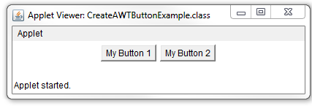
// Create AWT Button Example // This java example shows how to create a Button using AWT Button class. import java.applet.Applet; import java.awt.Button; /* <applet code="CreateAWTButtonExample" width=200 height=200> </applet> */ public class CreateAWTButtonExample extends Applet{ public void init(){ /* * To create a button use * Button() constructor. */ Button button1 = new Button(); /* * Set button caption or label using * void setLabel(String text) * method of AWT Button class. */ button1.setLabel("My Button 1"); /* * To create button with the caption use * Button(String text) constructor of * AWT Button class. */ Button button2 = new Button("My Button 2"); //add buttons using add method add(button1); add(button2); } }

Slide 8
Links for API Resources
You need to check the JDK API specification (http://docs.oracle.com/javase/7/docs/api/index.html) for the AWT and Swing APIs while reading this chapter. The best online reference for Graphics programming is the "Swing Tutorial" @ http://docs.oracle.com/javase/tutorial/uiswing/. For advanced 2D graphics programming, read "Java 2D Tutorial" @ http://docs.oracle.com/javase/tutorial/2d/index.html.

Slide 9
Programming GUI with AWT
Java Graphics APIs - AWT and Swing - provide a huge set of reusable GUI components, such as:
Button
text field label,
choice,
panel and
frame
for building GUI applications.

Slide 10
AWT Packages
AWT is huge! It consists of 12 packages
Swing is even bigger, with 18 packages as of JDK 1.7!.
Fortunately, only 2 packages - java.awt andjava.awt.event - are commonly-used.
The java.awt package contains the core AWT graphics classes:
GUI Component classes (such as Button, TextField, and Label),
GUI Container classes (such as Frame, Panel, Dialog and ScrollPane),
Layout managers (such as FlowLayout, BorderLayout and GridLayout),
Custom graphics classes (such as Graphics, Color and Font).
The java.awt.event package supports event handling:
Event classes (such as ActionEvent, MouseEvent, KeyEvent and WindowEvent),
Event Listener Interfaces (such as ActionListener, MouseListener, KeyListener and WindowListener),
Event Listener Adapter classes (such as MouseAdapter, KeyAdapter, and WindowAdapter).
AWT provides a platform-independent and device-independent interface to develop graphic programs that runs on all platforms, such as Windows, Mac, and Linux.

Slide 11
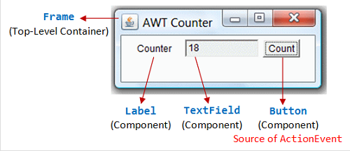
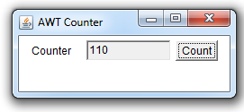
import java.awt.*; // Using AWT container and component classes import java.awt.event.*; // Using AWT event classes and listener interfaces // An AWT program inherits from the top-level container java.awt.Frame public class AWTCounter extends Frame implements ActionListener { private Label lblCount; // Declare component Label private TextField tfCount; // Declare component TextField private Button btnCount; // Declare component Button private int count = 0; // Counter's value /** Constructor to setup GUI components and event handling */ public AWTCounter () { setLayout(new FlowLayout()); // "super" Frame sets its layout to FlowLayout, which arranges the components // from left-to-right, and flow to next row from top-to-bottom. lblCount = new Label("Counter"); // construct Label add(lblCount); // "super" Frame adds Label tfCount = new TextField("0", 10); // construct TextField tfCount.setEditable(false); // set to read-only add(tfCount); // "super" Frame adds tfCount btnCount = new Button("Count"); // construct Button add(btnCount); // "super" Frame adds Button btnCount.addActionListener(this); // Clicking Button source fires ActionEvent // btnCount registers this instance as ActionEvent listener setTitle("AWT Counter"); // "super" Frame sets title setSize(250, 100); // "super" Frame sets initial window size // System.out.println(this); // System.out.println(lblCount); // System.out.println(tfCount); // System.out.println(btnCount);
setVisible(true); // "super" Frame shows
// System.out.println(this); // System.out.println(lblCount); // System.out.println(tfCount); // System.out.println(btnCount);
}
/** The entry main() method */ public static void main(String[] args) { // Invoke the constructor to setup the GUI, by allocating an instance AWTCounter app = new AWTCounter(); } /** ActionEvent handler - Called back upon button-click. */ public void actionPerformed(ActionEvent evt) { ++count; // increase the counter value // Display the counter value on the TextField tfCount tfCount.setText(count + ""); // convert int to String } }
Output
Example: AWT Counter

Slide 12
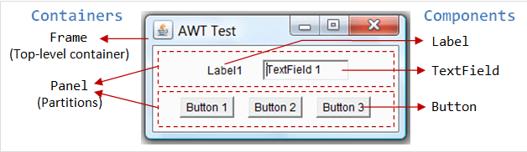
Containers and Components
There are two types of GUI elements:
Component: Components are elementary GUI entities (such asButton, Label, and TextField.)
Container: Containers (such as Frame, Panel and Applet) are used to hold components in a specific layout (such as flow or grid). A container can also hold sub-containers.
GUI components are also called controls (Microsoft ActiveX Control),widgets (Eclipse's Standard Widget Toolkit, Google Web Toolkit), which allow users to interact with (i.e., control) the application through these components (such as button-click and text-entry).

Slide 13
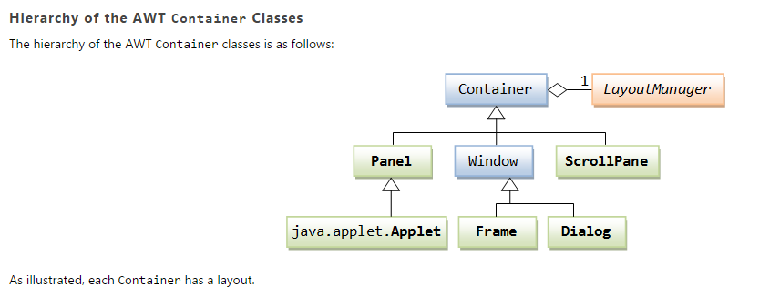
http://www3.ntu.edu.sg/home/ehchua/programming/java/j4a_gui.html

Slide 14
Basic Structure of JavaFX
Application
Override the start(Stage) method
Stage, Scene, and Nodes
MyJavaFX
Run
MultipleStageDemo
Run

Slide 15
Basic Structure of JavaFX
JavaFX application is divided hierarchically into three main components known as Stage, Scene and nodes. We need to import javafx.application.Application class in every JavaFX application. This provides the following life cycle methods for JavaFX application.
public void init()
public abstract void start(Stage primaryStage)
public void stop()
in order to create a basic JavaFX application, we need to:
Import javafx.application.Application into our code.
Inherit Application into our class.
Override start() method of Application class.

Slide 16
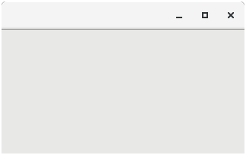
Basic Structure of JavaFX
Stage:
Stage in a JavaFX application is similar to the Frame in a Swing Application.
It acts like a container for all the JavaFX objects. Primary Stage is created internally by the platform. Other stages can further be created by the application.
The object of primary stage is passed to start method.
We need to call show method on the primary stage object in order to show our primary stage. Initially, the primary Stage looks like following.

Slide 17
Basic Structure of JavaFX
Scene:
Scene actually holds all the physical contents (nodes) of a JavaFX application. Javafx.scene.Scene class provides all the methods to deal with a scene object. Creating scene is necessary in order to visualize the contents on the stage.
Scene Graph:
Scene Graph exists at the lowest level of the hierarchy. It can be seen as the collection of various nodes. A node is the element which is visualized on the stage. It can be any button, text box, layout, image, radio button, check box, etc.
The nodes are implemented in a tree kind of structure. There is always one root in the scene graph.

Slide 18
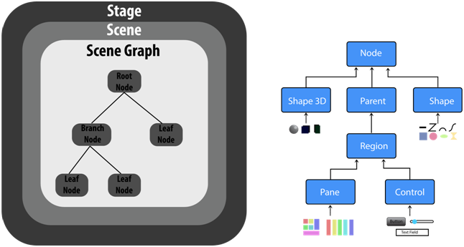
Basic Structure of JavaFX

Slide 19
First JavaFX Application
A simple JavaFX application which prints hello world on the console on clicking the button shown on the stage:
Step1: Extend javafx.application.Application and override start()
start() method is the starting point of constructing a JavaFX application therefore we need to first override start method of javafx.application.Application class.
Object of the class javafx.stage.Stage is passed into the start() method therefore import this class and pass its object into start method.
JavaFX.application.Application needs to be imported in order to override start method.
package application;
import javafx.application.Application;
import javafx.stage.Stage;
public class Hello_World extends Application{
@Override
public void start(Stage primaryStage) throws Exception {
// TODO Auto-generated method stub
}
}

Slide 20
Step 2: Create a Button
A button can be created by instantiating the javafx.scene.control.Button class. we have to import this class into our code. Pass the button label text in Button class constructor.
package application;
import javafx.application.Application;
Import javafx.scene.control.Button;
import javafx.stage.Stage;
public class Hello_World extends Application{
public void start(Stage primaryStage) throws Exception {
Button btn1=newButton("Say, Hello World");
}
}

Slide 21
Step 3: Create a layout and add button to it
JavaFX provides the number of layouts. We need to implement one of them in order to visualize the widgets properly. It exists at the top level of the scene graph and can be seen as a root node. All the other nodes (buttons, texts, etc.) need to be added to this layout.
In this application, we have implemented StackPane layout. It can be implemented by instantiating javafx.scene.layout.StackPane class.
package application;
import javafx.application.Application;
import javafx.scene.control.Button;
import javafx.stage.Stage;
import javafx.scene.layout.StackPane;
public class Hello_World extends Application{
public void start(Stage primaryStage) throws Exception {
Button btn1=new Button("Say, Hello World");
StackPane root=new StackPane();
root.getChildren().add(btn1);
}
}

Slide 22
Step 4: Create a Scene
The layout needs to be added to a scene. Scene remains at the higher level in the hierarchy of application structure. It can be created by instantiating javafx.scene.Scene class. We need to pass the layout object to the scene class constructor.
We can also pass the width and height of the required stage for the scene in the Scene class constructor.
package application;
import javafx.application.Application;
import javafx.scene.Scene;
import javafx.scene.control.Button;
import javafx.stage.Stage;
import javafx.scene.layout.StackPane;
public class Hello_World extends Application{
public void start(Stage primaryStage) throws Exception {
Button btn1=new Button("Say, Hello World");
StackPane root=new StackPane();
root.getChildren().add(btn1);
Scene scene=new Scene(root);
}
}

Slide 23
Step 5: Prepare the Stage
javafx.stage.Stage class provides some important methods which are required to be called to set some attributes for the stage. We can set the title of the stage. We also need to call show() method without which, the stage won't be shown.
package application;
import javafx.application.Application;
import javafx.scene.Scene;
import javafx.scene.control.Button;
import javafx.stage.Stage;
import javafx.scene.layout.StackPane;
public class Hello_World extends Application{
public void start(Stage primaryStage) throws Exception {
Button btn1=new Button("Say, Hello World");
StackPane root=new StackPane();
root.getChildren().add(btn1);
Scene scene=new Scene(root);
primaryStage.setScene(scene);
primaryStage.setTitle("First JavaFX Application");
primaryStage.show();
}
}

Slide 24
Step 6: Create an event for the button
As our application prints hello world for an event on the button. We need to create an event for the button. For this purpose, call setOnAction() on the button and define a anonymous class Event Handler as a parameter to the method.
package application;
import javafx.application.Application;
import javafx.event.ActionEvent;
import javafx.event.EventHandler;
import javafx.scene.Scene;
import javafx.scene.control.Button;
import javafx.stage.Stage;
import javafx.scene.layout.StackPane;
public class Hello_World extends Application{
public void start(Stage primaryStage) throws Exception {
Button btn1=new Button("Say, Hello World");
btn1.setOnAction(new EventHandler<ActionEvent>() {
public void handle(ActionEvent arg0) {
System.out.println("hello world");
}
}};
StackPane root=new StackPane();
root.getChildren().add(btn1);
Scene scene=new Scene(root,600,400);
primaryStage.setScene(scene);
primaryStage.setTitle("First JavaFX Application");
primaryStage.show();
}
}

Slide 25
package application;
import javafx.application.Application;
import javafx.event.ActionEvent;
import javafx.event.EventHandler;
import javafx.scene.Scene;
import javafx.scene.control.Button;
import javafx.stage.Stage;
import javafx.scene.layout.StackPane;
public class Hello_World extends Application{
public void start(Stage primaryStage) throws Exception {
Button btn1=new Button("Say, Hello World");
btn1.setOnAction(new EventHandler<ActionEvent>() {
public void handle(ActionEvent arg0) {
System.out.println("hello world");
}
}};
StackPane root=new StackPane();
root.getChildren().add(btn1);
Scene scene=new Scene(root,600,400);
primaryStage.setTitle("First JavaFX Application");
primaryStage.setScene(scene);
primaryStage.show();
}
publicstaticvoid main (String[] args)
{
launch(args);
}
}
Step 7: Create the main method
Till now, we have configured all the necessary things which are required to develop a basic JavaFX application.
We have not created main method yet. Hence, at the last, we need to create a main method in which we will launch the application i.e. will call launch() method and pass the command line arguments (args) to it.

Slide 26
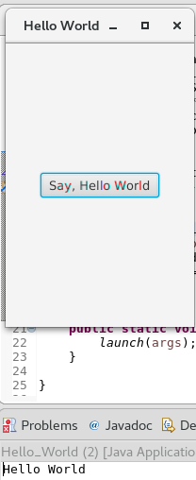
The Application will produce this output on the screen.

Slide 27
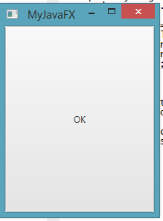
My JavaFx
MultipleStage Demo
import javafx.application.Application; import javafx.scene.Scene; import javafx.scene.control.Button; import javafx.stage.Stage; public class MyJavaFX extends Application { @Override // Override the start method in the Application class public void start(Stage primaryStage) { // Create a button and place it in the scene Button btOK = new Button("OK"); Scene scene = new Scene(btOK, 200, 250); primaryStage.setTitle("MyJavaFX"); // Set the stage title primaryStage.setScene(scene); // Place the scene in the stage primaryStage.show(); // Display the stage } /** * The main method is only needed for the IDE with limited * JavaFX support. Not needed for running from the command line. */ public static void main(String[] args) { launch(args); } }
import javafx.application.Application; import javafx.scene.Scene; import javafx.scene.control.Button; import javafx.stage.Stage; public class MultipleStageDemo extends Application { @Override // Override the start method in the Application class public void start(Stage primaryStage) { // Create a scene and place a button in the scene Scene scene = new Scene(new Button("OK"), 200, 250); primaryStage.setTitle("MyJavaFX"); // Set the stage title primaryStage.setScene(scene); // Place the scene in the stage primaryStage.show(); // Display the stage Stage stage = new Stage(); // Create a new stage stage.setTitle("Second Stage"); // Set the stage title // Set a scene with a button in the stage stage.setScene(new Scene(new Button("New Stage"), 100, 100)); stage.show(); // Display the stage } /** * The main method is only needed for the IDE with limited * JavaFX support. Not needed for running from the command line. */ //public static void main(String[] args) { // launch(args); // } }

Slide 28
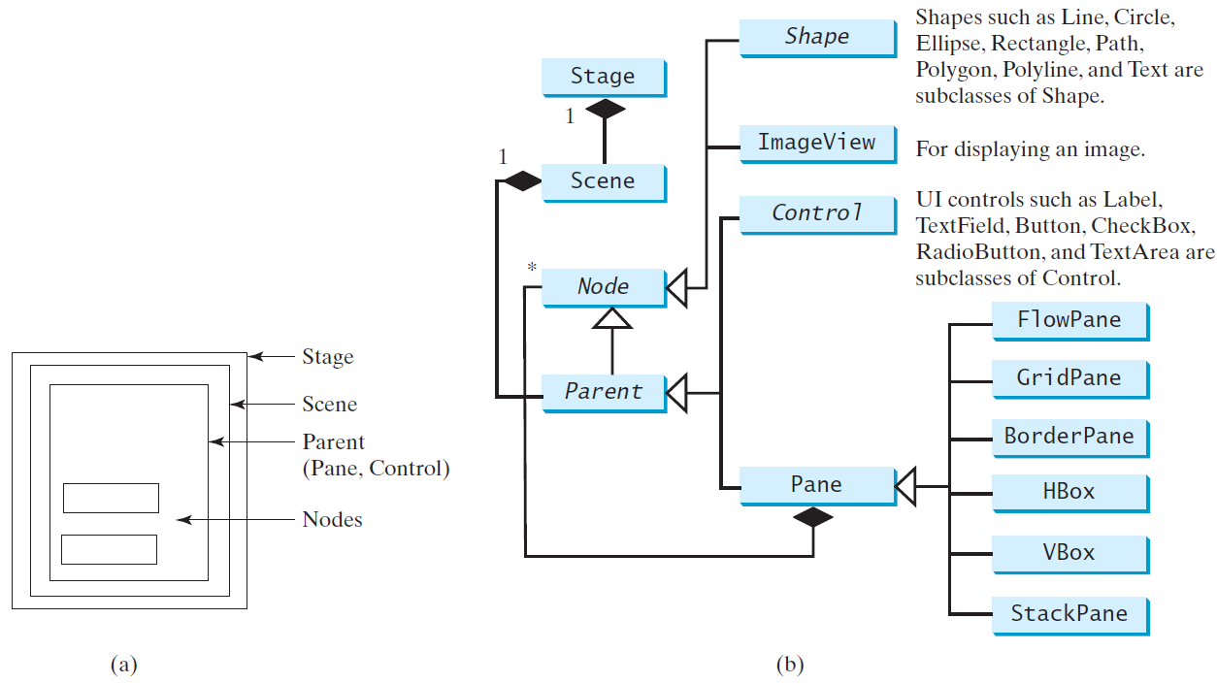
Panes, UI Controls, and Shapes
ButtonInPane
Run

Slide 29
Display a Shape
This example displays a circle in the center of the pane.
ShowCircle
Run

Slide 30
JavaFX Cirlce
JavaFX allows us to create Circle on the GUI of any application by just instantiating javafx.scene.shape.Circle class.
Property | Description | Setter Methods
centerX | X coordinate of the centre of circle | setCenterX(Double value)
centerY | Y coordinate of the centre of circle | setCenterY(Double value)
radious | Radius of the circle | setRadius(Double value)

Slide 31
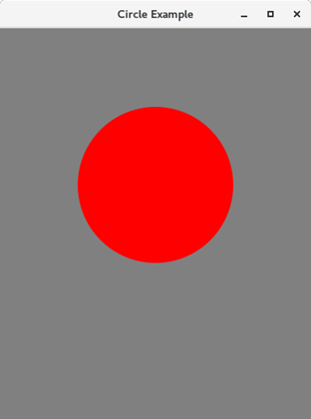
package application;
import javafx.application.Application;
import javafx.scene.Group;
import javafx.scene.Scene;
import javafx.scene.paint.Color;
import javafx.scene.shape.Circle;
import javafx.stage.Stage;
public class Shape_Example extends Application{
public void start(Stage primaryStage) throws Exception {
primaryStage.setTitle("Circle Example");
Group group = new Group();
Circle circle = new Circle();
circle.setCenterX(200);
circle.setCenterY(200);
circle.setRadius(100);
circle.setFill(Color.RED);
group.getChildren().addAll(circle);
Scene scene = new Scene(group,400,500,Color.GRAY);
primaryStage.setScene(scene);
primaryStage.show();
}
public static void main(String[] args) {
launch(args);
}
}

Slide 32
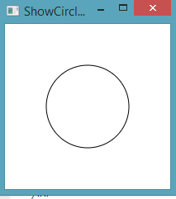
Binding Properties
import javafx.application.Application; import javafx.scene.Scene; import javafx.scene.layout.Pane; import javafx.scene.paint.Color; import javafx.scene.shape.Circle; import javafx.stage.Stage; public class ShowCircleCentered extends Application { public void start(Stage primaryStage) { // Create a pane to hold the circle Pane pane = new Pane(); // Create a circle and set its properties Circle circle = new Circle(); circle.centerXProperty().bind(pane.widthProperty().divide(2)); circle.centerYProperty().bind(pane.heightProperty().divide(2)); circle.setRadius(50); circle.setStroke(Color.BLACK); circle.setFill(Color.WHITE); pane.getChildren().add(circle); // Add circle to the pane // Create a scene and place it in the stage Scene scene = new Scene(pane, 200, 200); primaryStage.setTitle("ShowCircleCentered"); // Set the stage title primaryStage.setScene(scene); // Place the scene in the stage primaryStage.show(); // Display the stage } /** * The main method is only needed for the IDE with limited * JavaFX support. Not needed for running from the command line. */ public static void main(String[] args) { launch(args); } }
ShowCircleCentered
JavaFX introduces a new concept called binding property that enables a target object to be bound to a source object. If the value in the source object changes, the target property is also changed automatically. The target object is simply called a binding object or a binding property.

Slide 33
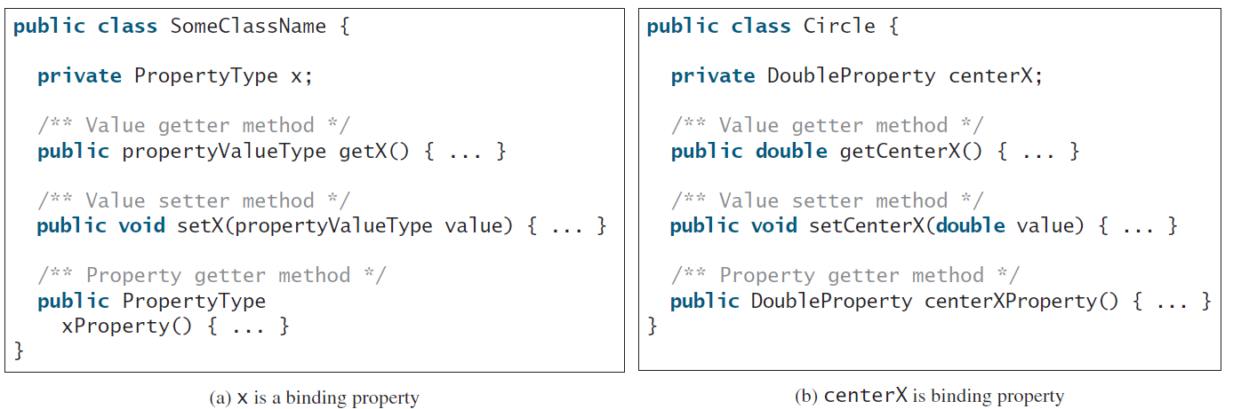
Binding Property: getter, setter, and property getter

Slide 34
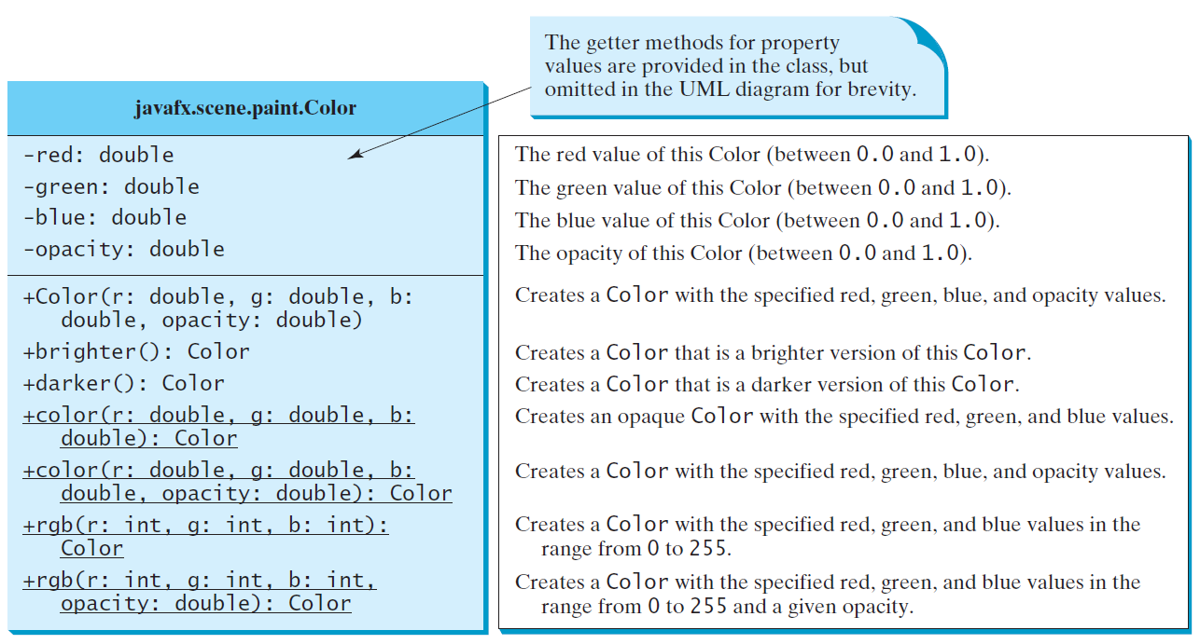
The Color Class

Slide 35
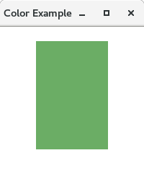
package application;
import javafx.application.Application;
import javafx.scene.Group;
import javafx.scene.Scene;
import javafx.scene.effect.DropShadow;
import javafx.scene.effect.Shadow;
import javafx.scene.paint.Color;
import javafx.scene.shape.Rectangle;
import javafx.stage.Stage;
public class Shape_Example extends Application
public void start(Stage primarystage) {
Group root = new Group();
primarystage.setTitle("Color Example");
Rectangle rect = new Rectangle();
rect.setX(50);
rect.setY(20);
rect.setWidth(100);
rect.setHeight(150);
int red=20;
int green=125;
int blue=10;
rect.setFill(Color.rgb(red, green, blue,0.63));
root.getChildren().add(rect);
Scene scene = new Scene(root,200,200);
primarystage.setScene(scene);
primarystage.show();
}
public static void main(String[] args) {
launch(args);
}
}
RGB Color
RGB color system is the most popular method to create a color in graphics. It consists of three components named as RED → R, GREEN → G and BLUE → B. Each component uses 8 Bits that means every component can have the integer value from 0 to 22^8 - 1=255.
There is a static method named as rgb() of Color class. It accepts three integer arguments as Red, Green, Blue and one optional double argument called alpha. The value of alpha is proportional to the opacity of the color.

Slide 36
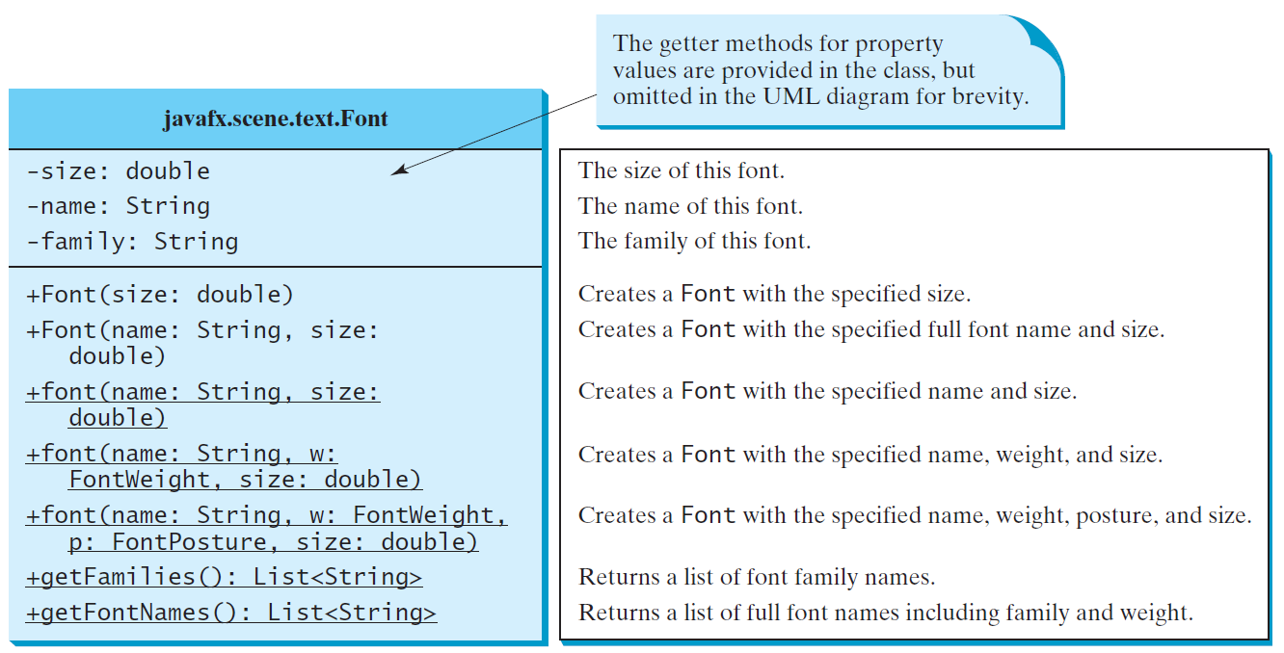
The Font Class
FontDemo
Run

Slide 37
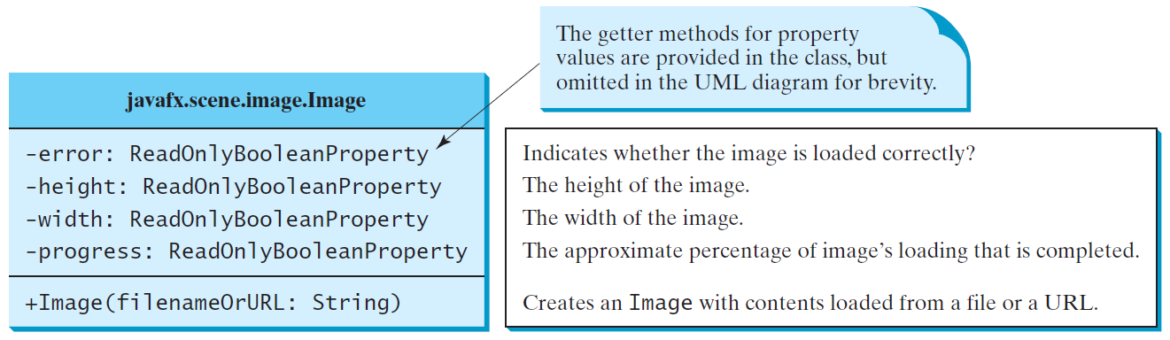
The Image Class

Slide 38
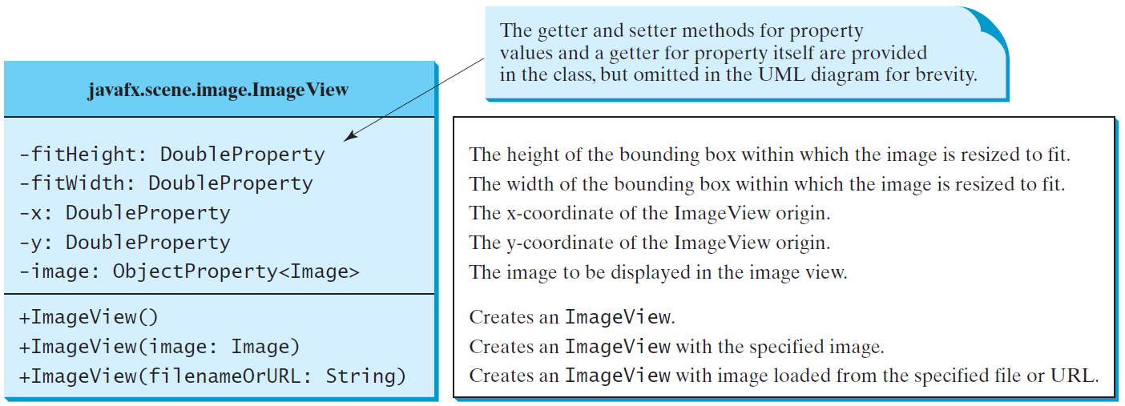
The ImageView Class
ShowImage
Run

Slide 39
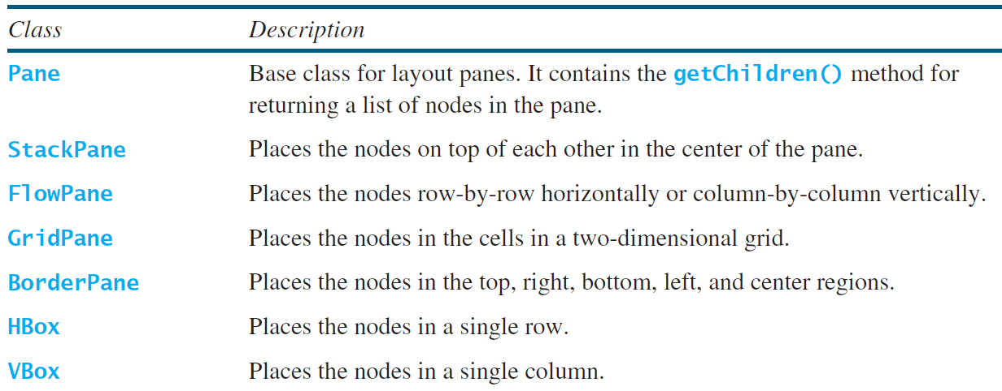
Layout Panes
JavaFX provides many types of panes for organizing nodes in a container.

Slide 40
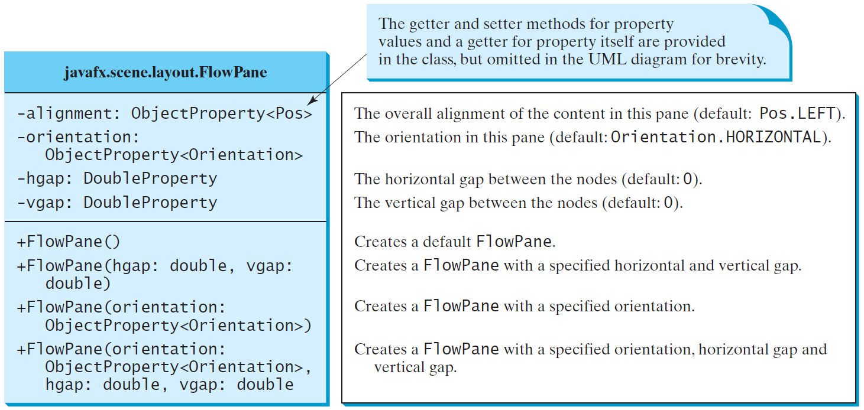
FlowPane
ShowFlowPane
Run

Slide 41
JavaFX FlowPane
FlowPane layout pane organizes the nodes in a flow that are wrapped at the flowpane's boundary. The horizontal flowpane arranges the nodes in a row and wrap them according to the flowpane's width. The vertical flowpane arranges the nodes in a column and wrap them according to the flowpane's height.
Property | Description | Setter Methods
alignment | The overall alignment of the flowpane's content. | setAlignment(Pos value)
columnHalignment | The horizontal alignment of nodes within the columns. | setColumnHalignment(HPos Value)
hgap | Horizontal gap between the columns. | setHgap(Double value)
orientation | Orientation of the flowpane | setOrientation(Orientation value)
prefWrapLength | The preferred height or width where content should wrap in the horizontal or vertical flowpane. | setPrefWrapLength(double value)
rowValignment | The vertical alignment of the nodes within the rows. | setRowValignment(VPos value)
vgap | The vertical gap among the rows | setVgap(Double value)

Slide 42
FlowPane
Constructors
There are 8 constructors in the class that are given below.
FlowPane()
FlowPane(Double Hgap, Double Vgap)
FlowPane(Double Hgap, Double Vgap, Node? children)
FlowPane(Node... Children)
FlowPane(Orientation orientation)
FlowPane(Orientation orientation, double Hgap, Double Vgap)
FlowPane(Orientation orientation, double Hgap, Double Vgap, Node? children )
FlowPane(Orientation orientation, Node... Children)

Slide 43
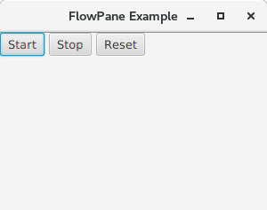
FlowPane
package application;
import javafx.application.Application;
import javafx.scene.Scene;
import javafx.scene.control.Button;
import javafx.scene.layout.FlowPane;
import javafx.stage.Stage;
public class FlowPaneTest extends Application {
public void start(Stage primaryStage) {
primaryStage.setTitle("FlowPane Example");
FlowPane root = new FlowPane();
root.setVgap(6);
root.setHgap(5);
root.setPrefWrapLength(250);
root.getChildren().add(new Button("Start"));
root.getChildren().add(new Button("Stop"));
root.getChildren().add(new Button("Reset"));
Scene scene = new Scene(root,300,200);
primaryStage.setScene(scene);
primaryStage.show();
}
public static void main(String[] args) {
launch(args);
}
}

Slide 44
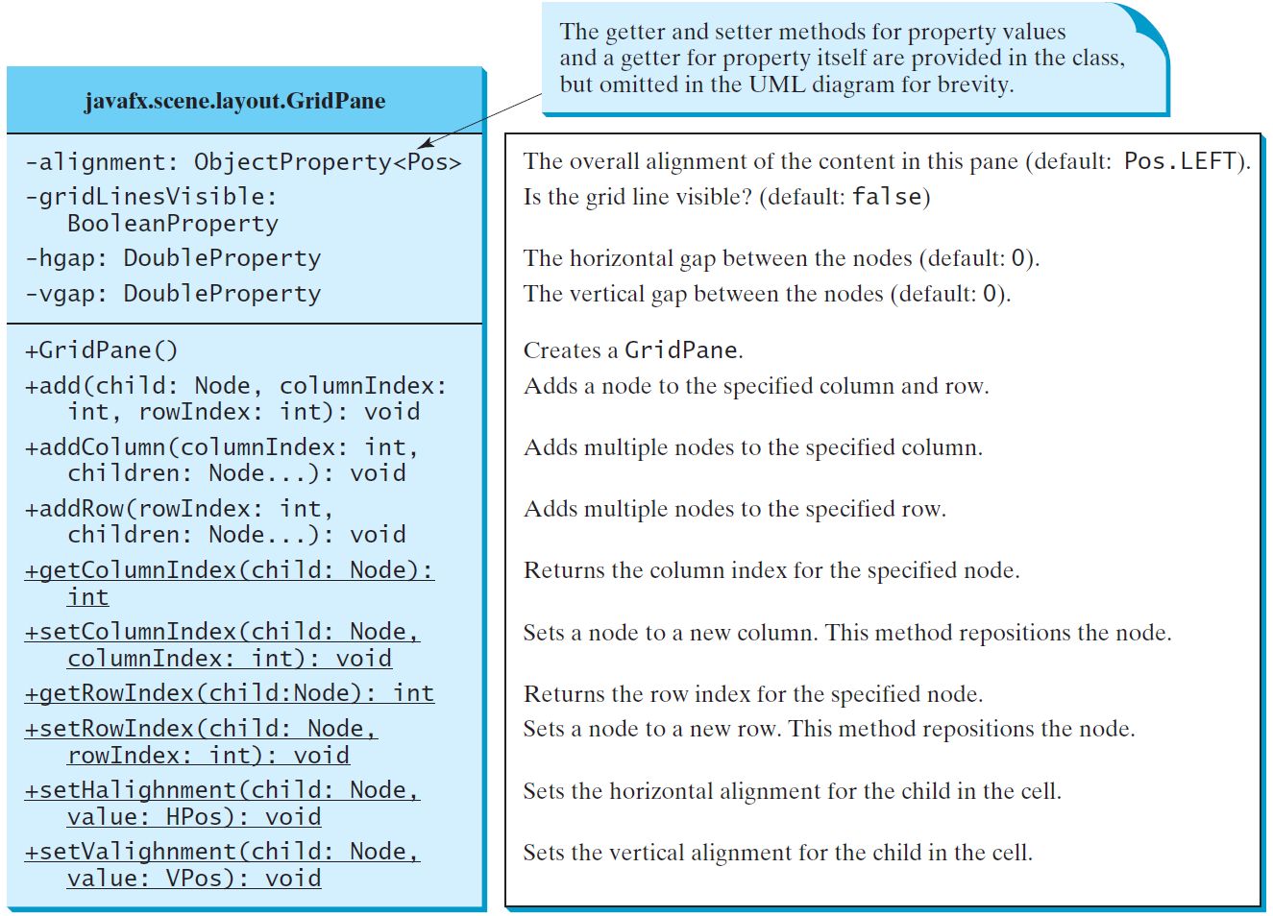
GridPane
ShowGridPane
Run

Slide 45
JavaFX GridPane
GridPane Layout pane allows us to add the multiple nodes in multiple rows and columns. It is seen as a flexible grid of rows and columns where nodes can be placed in any cell of the grid.
Property | Description | Setter Methods
alignment | Represents the alignment of the grid within the GridPane. | setAlignment(Pos value)
gridLinesVisible | This property is intended for debugging. Lines can be displayed to show the gidpane's rows and columns by setting this property to true. | setGridLinesVisible(Boolean value)
hgap | Horizontal gaps among the columns | setHgap(Double value)
vgap | Vertical gaps among the rows | setVgap(Double value)
Constructors
The class contains only one constructor:
Public GridPane(): creates a gridpane with 0 hgap/vgap.

Slide 46
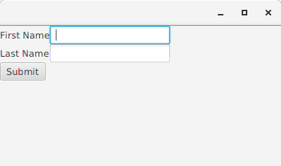
GridPane
package application;
import javafx.application.Application;
import javafx.scene.Scene;
import javafx.scene.control.Button;
import javafx.scene.control.Label;
import javafx.scene.control.TextField;
import javafx.scene.layout.GridPane;
import javafx.stage.Stage;
public class Label_Test extends Application {
public void start(Stage primaryStage) throws Exception {
Label first_name=new Label("First Name");
Label last_name=new Label("Last Name");
TextField tf1=new TextField();
TextField tf2=new TextField();
Button Submit=new Button ("Submit");
GridPane root=new GridPane();
Scene scene = new Scene(root,400,200);
root.addRow(0, first_name,tf1);
root.addRow(1, last_name,tf2);
root.addRow(2, Submit);
primaryStage.setScene(scene);
primaryStage.show();
}
public static void main(String[] args) {
launch(args);
}
}

Slide 47
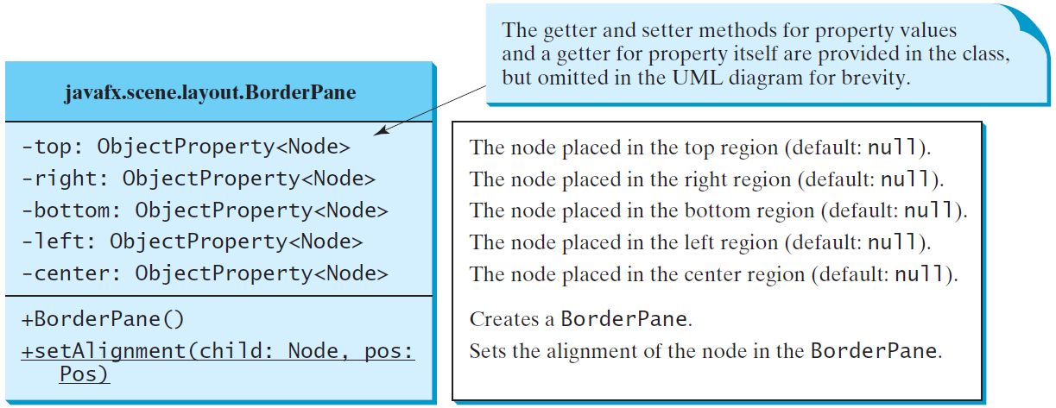
BorderPane
ShowBorderPane
Run

Slide 48
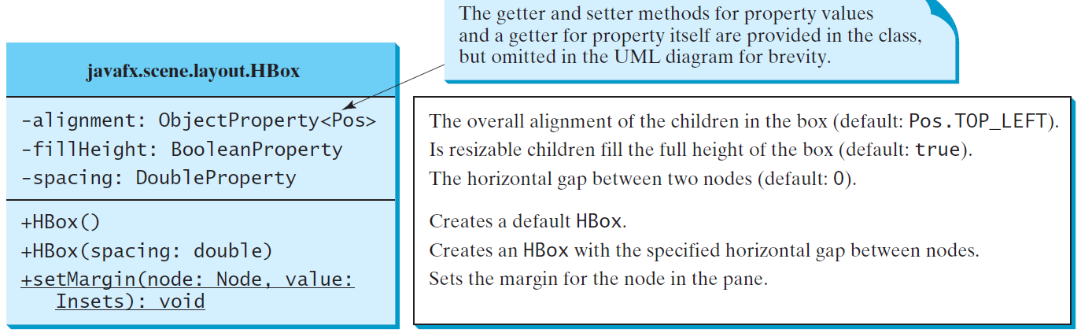
HBox

Slide 49
HBox
JavaFX HBox
HBox layout pane arranges the nodes in a single row. It is represented by javafx.scene.layout.HBox class
Property | Description | Setter Methods
alignment | This represents the alignment of the nodes. | setAlignment(Double)
fillHeight | This is a boolean property. If you set this property to true the height of the nodes will become equal to the height of the HBox. | setFillHeight(Double)
spacing | This represents the space between the nodes in the HBox. It is of double type. | setSpacing(Double)

Slide 50
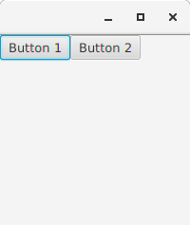
HBox
package application;
import javafx.application.Application;
import javafx.scene.Scene;
import javafx.scene.control.Button;
import javafx.scene.layout.HBox;
import javafx.stage.Stage;
public class Label_Test extends Application {
public void start(Stage primaryStage) throws Exception {
Button btn1 = new Button("Button 1");
Button btn2 = new Button("Button 2");
HBox root = new HBox();
Scene scene = new Scene(root,200,200);
root.getChildren().addAll(btn1,btn2);
primaryStage.setScene(scene);
primaryStage.show();
}
public static void main(String[] args) {
launch(args);
}

Slide 51
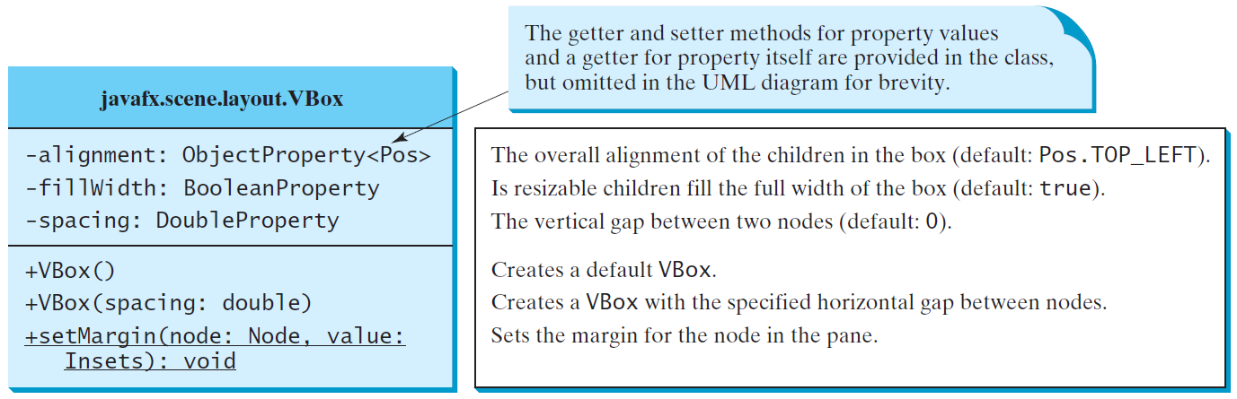
VBox
ShowHBoxVBox
Run

Slide 52
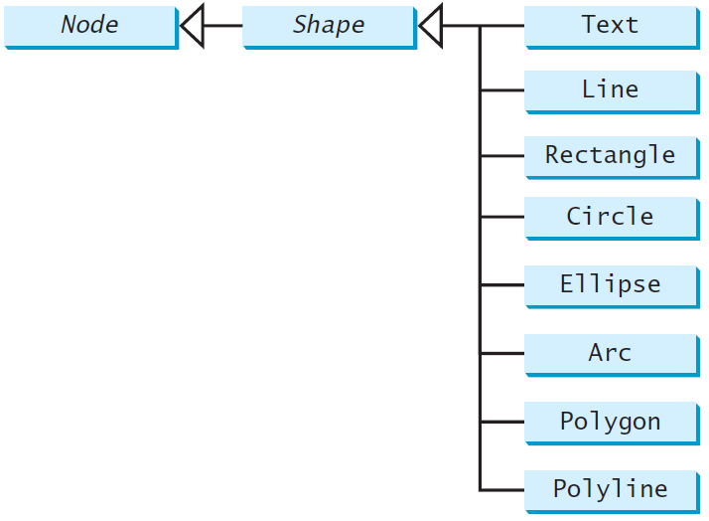
Shapes
JavaFX provides many shape classes for drawing texts, lines, circles, rectangles, ellipses, arcs, polygons, and polylines.

Slide 53
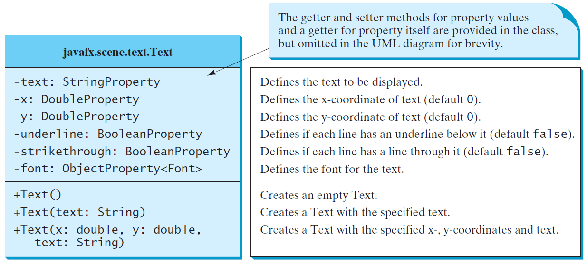
Text

Slide 54
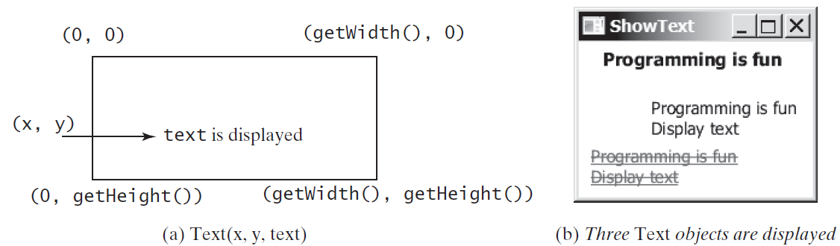
Text Example
ShowText
Run

Slide 55
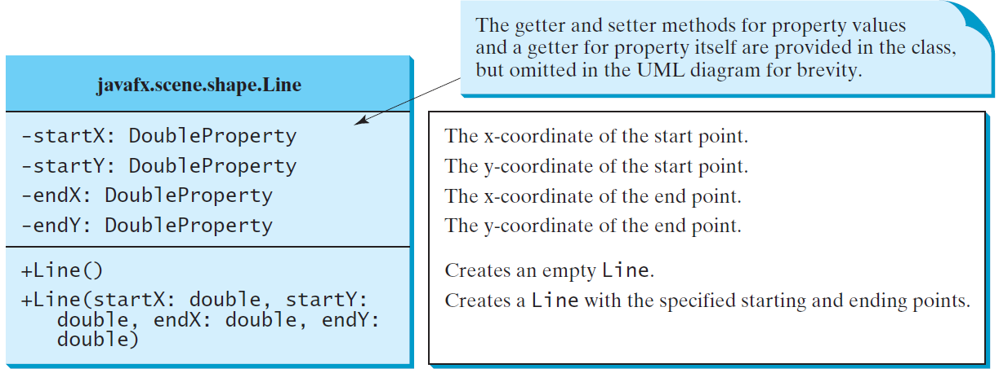
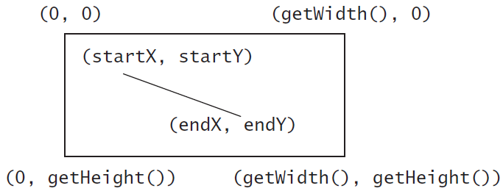
Line
ShowLine
Run

Slide 56
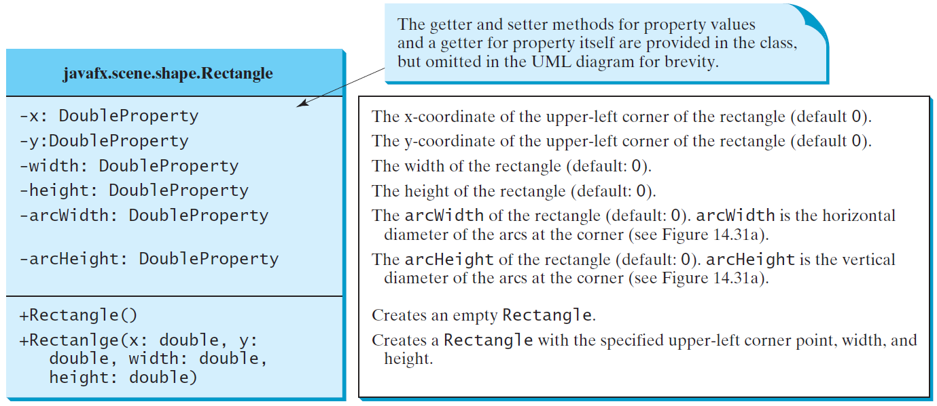
Rectangle

Slide 57
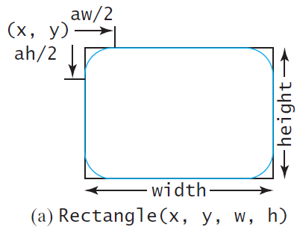
Rectangle Example
ShowRectangle
Run

Slide 58
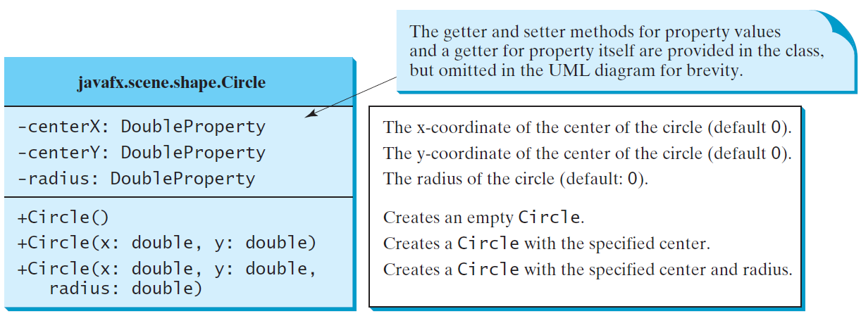
Circle

Slide 59
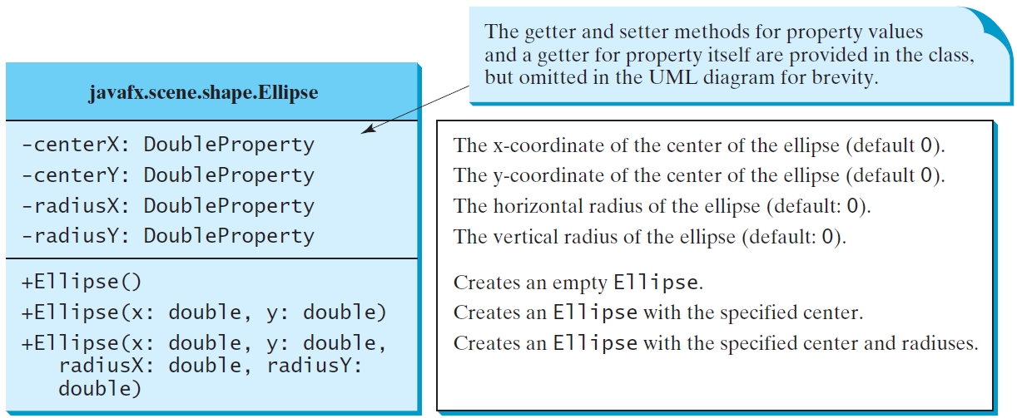
Ellipse
ShowEllipse
Run

Slide 60
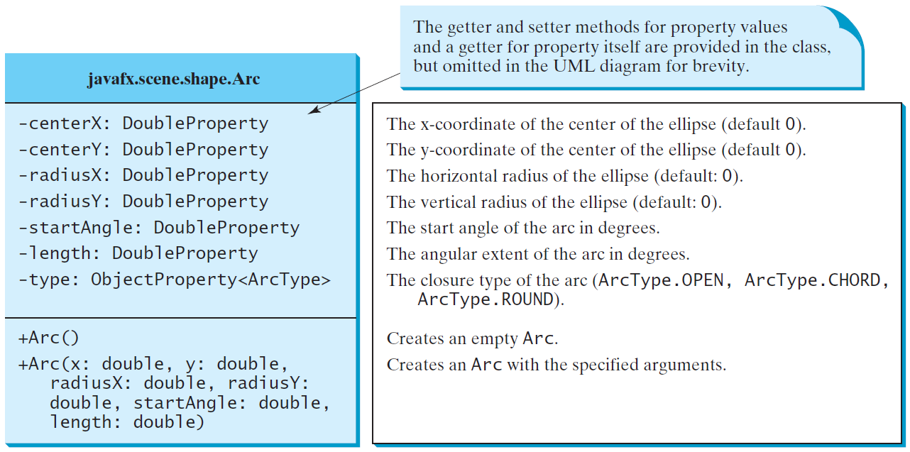
Arc

Slide 61
Arc Examples
ShowArc
Run

Slide 62
Polygon and Polyline
ShowArc
Run

Slide 63
Polygon
ShowPolygon
Run

Slide 64
Case Study: The ClockPane Class
This case study develops a class that displays a clock on a pane.
ClockPane

